Slide 1


Android Workshop
By
Nishikant Nandkumar Shinde. (Senior Android Developer)

Slide 2
Workshop Highlight:-
Introduction.
Working with Android Studio.
Android project structure.
Designing of Front-End using XML.
Designing of Back-End using Java.
Develop Android Application.

Slide 3
Introduction
Core Java
What is Android? And History of Android
Android Architecture
Android Components

Slide 4
Core Java
Abstraction
Polymorphism
Inheritance
Encapsulation

Slide 5
Android & It’s History
Release in 2008
Open Source language
Marketing Target
Package manager
Kernel type
Android version

Slide 6
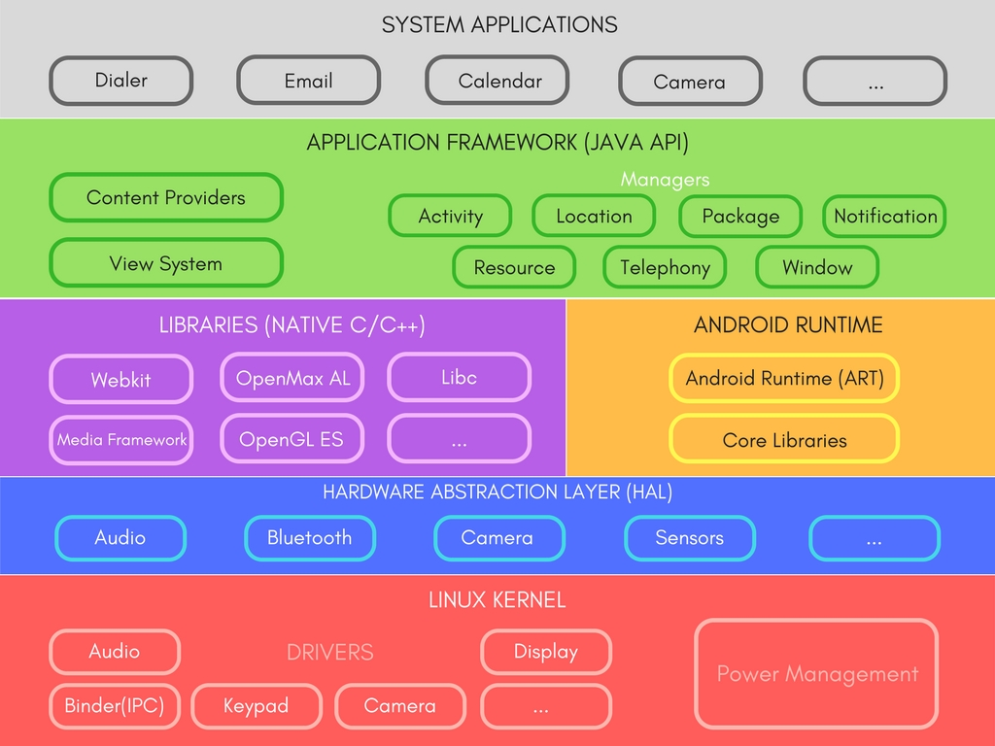
Android Architecture

Slide 7
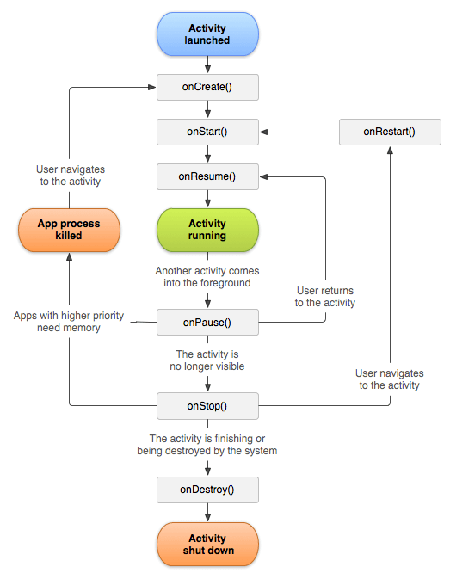
Android Components

Slide 8
Activities
Recycler List View
Intent
Toast / Snack bar
Shared Preferences
Bundle

Slide 9
Working with Android Studio
Hardware requirement
Software requirement
Version
Why to use Android studio and not to Eclipse
SDK

Slide 10
Android Project Structure
Designing of Front-End using XML
Designing of Back-End using JAVA
Develop Android application

Slide 11
Thank You
Nishikant Nandkumar Shinde (Senior Android Developer & Freelancer)
Mobile Number :- 9607593859 / 9404652091
Email ID :- nishikantshinde04@gmail.com

